Slide 1
Mixed-effect modeling: How to translate your research question into a model?
Andrew Chang
Postdoc at Poeppel Lab
Department of Psychology, NYU

Slide 2
A hypothetical study
Artist | Alcohol use | creativity
S1 | 123 | 963
S1 | 321 | 741
S1 | … | …
S1
S2 | 534 | 96
S2 | 999 | 74
S2 | … | …
S2
S3 | 222 | 82
S3 | 52 | 69
S3 | … | …
S3
S4 | 354 | 84
S4 | 234 | 124
S4 | … | …
S4
The relationship between alcohol use and creativity
Recruit 4 artists, and measure their daily alcohol use and creativity

Slide 3
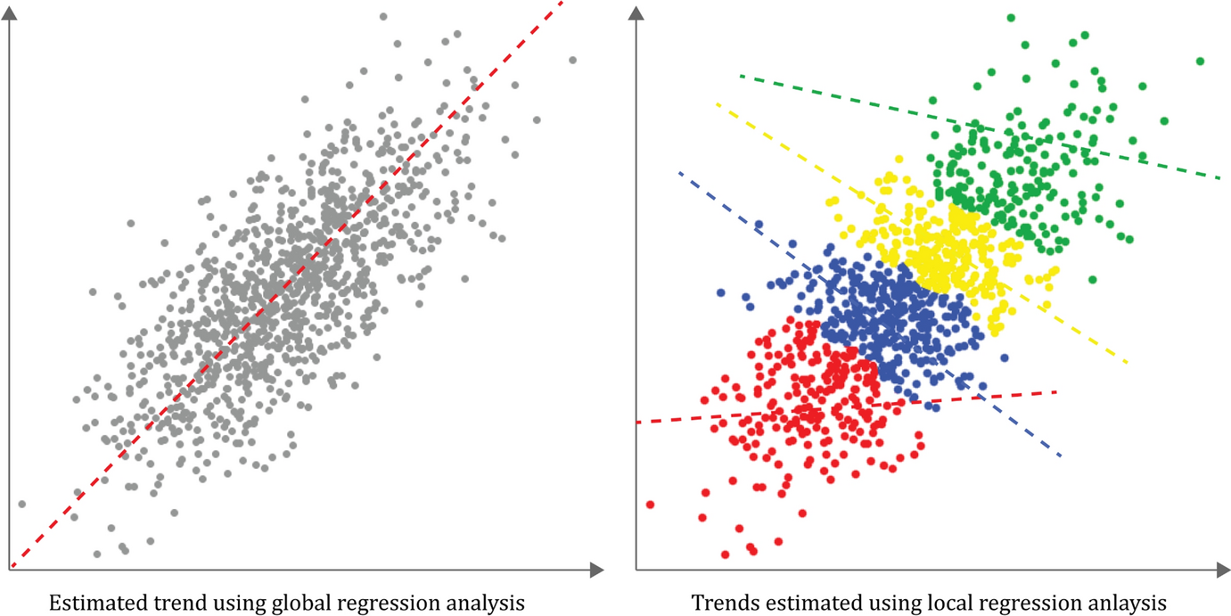
Put all observations into a linear regression?
Creativity
Alcohol use
https://link.springer.com/article/10.1007/s10109-021-00371-5/figures/15

Slide 4
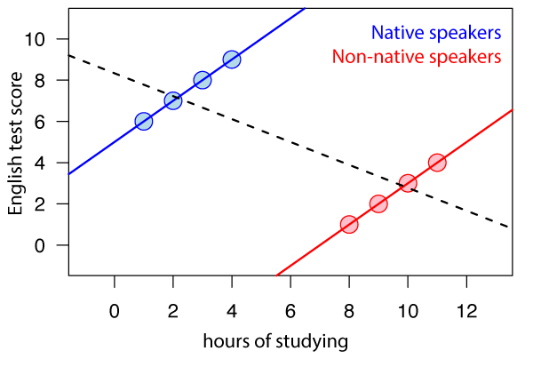
Revised from https://en.wikipedia.org/wiki/Simpson%27s_paradox

Slide 5
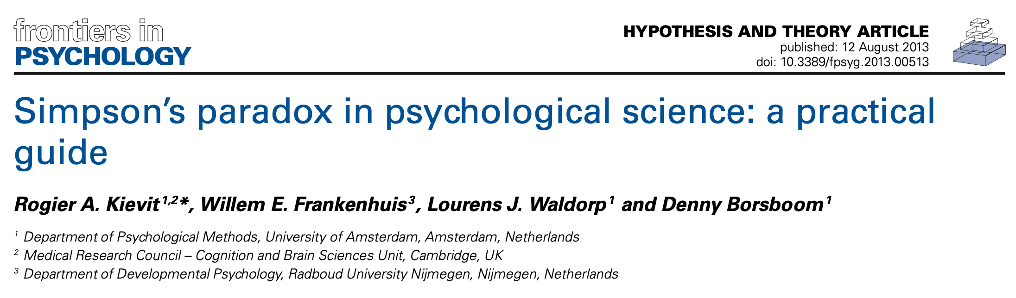
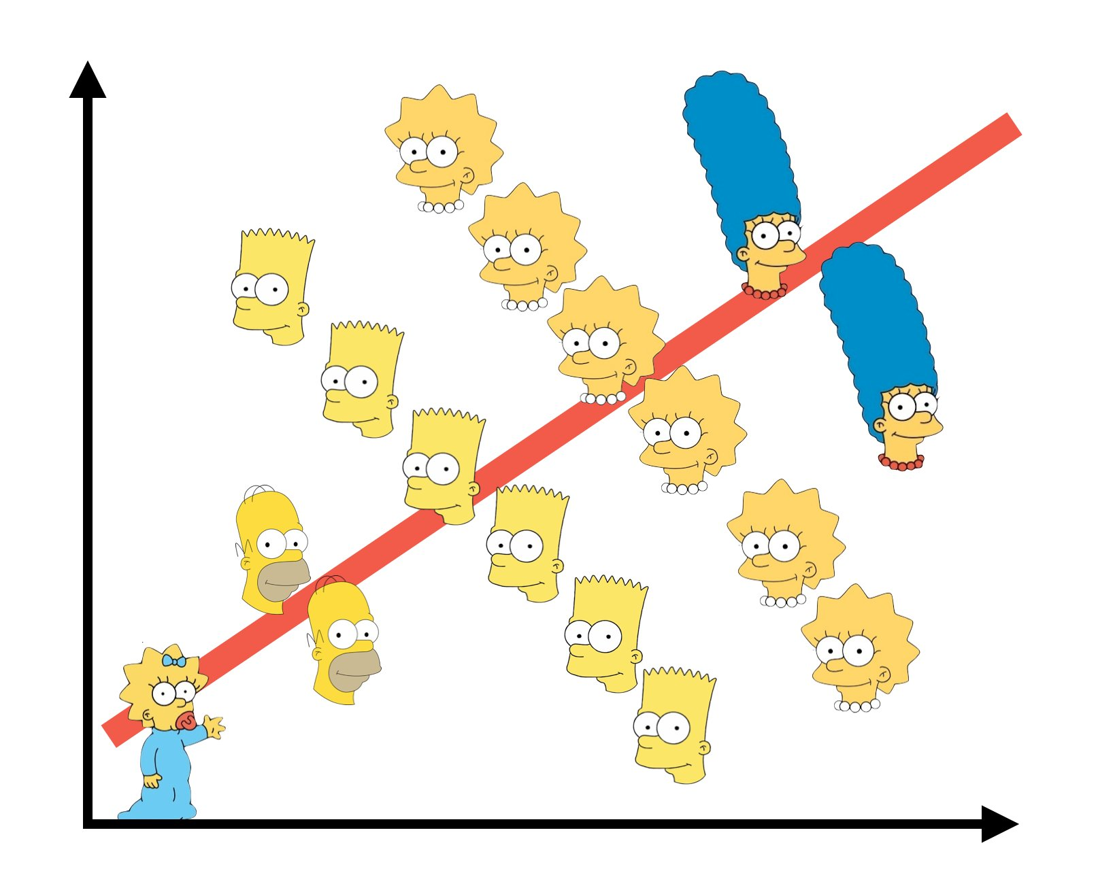
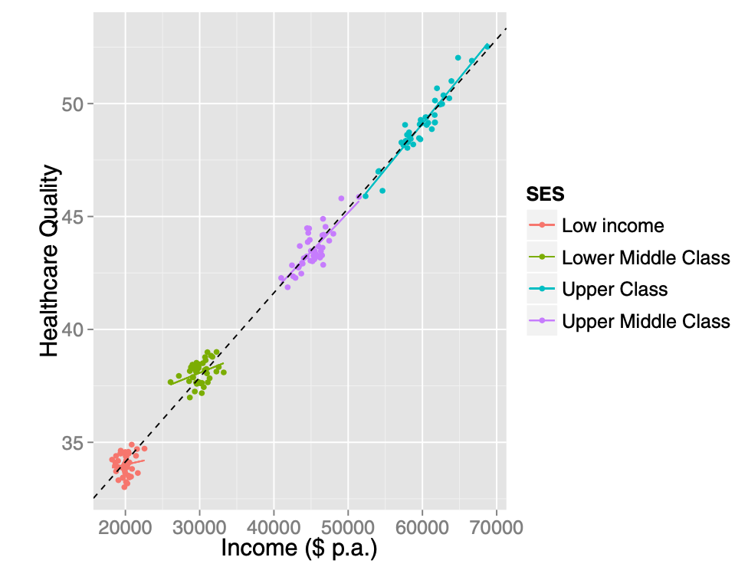
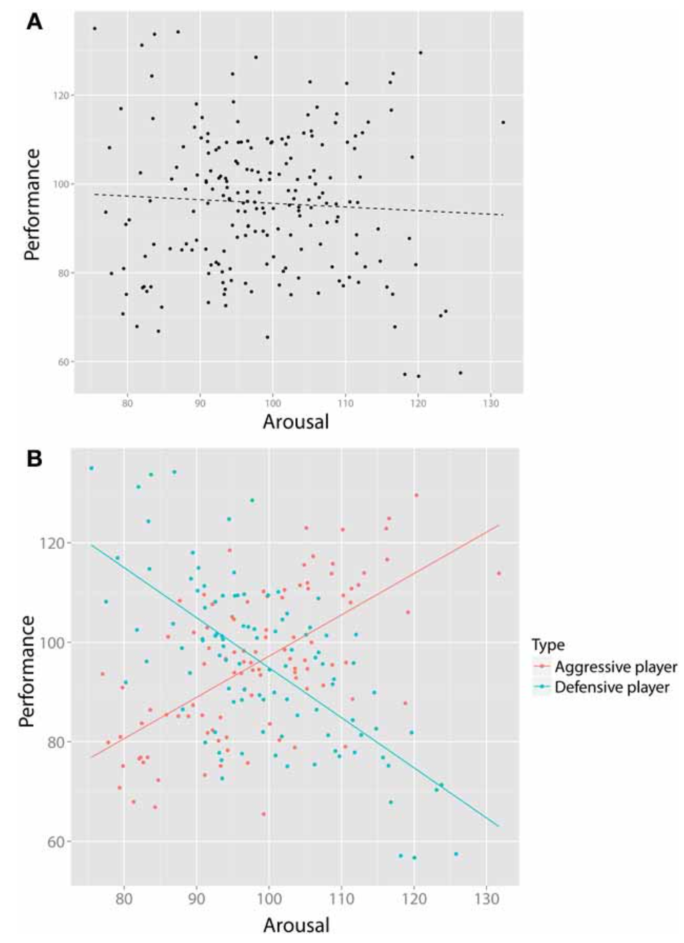
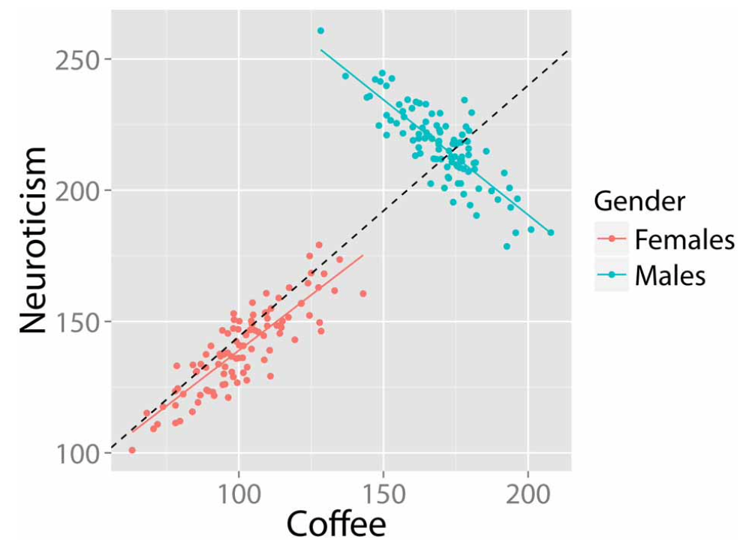
Simpson’s paradox
@infowetrust

Slide 6
Pseudoreplication: when observations are not statistically independent, but treated as if they are.

Slide 7
Use mixed effect modeling to fix pseudoreplication
Common cases of pseudoreplication
Same subject
Same group
According to the domain knowledge and/or sampling methods

Slide 8
Mixed effect model: Fixed effect + Random effect

Slide 9
Linear regression model
Fixed effect: intercept
Fixed effect: slope
Linear mixed effect model
Random effect: intercept
Random effect: slope

Slide 10
Fixed vs Random effects
Fixed: usually the effects you are interested in
Experimental manipulations
Independent variables
One value across all subjects/groups/clusters
Random: usually the pseudoreplication you want to get rid of
Individual differences
Baseline differences
Unique value for each subject/group/cluster

Slide 11
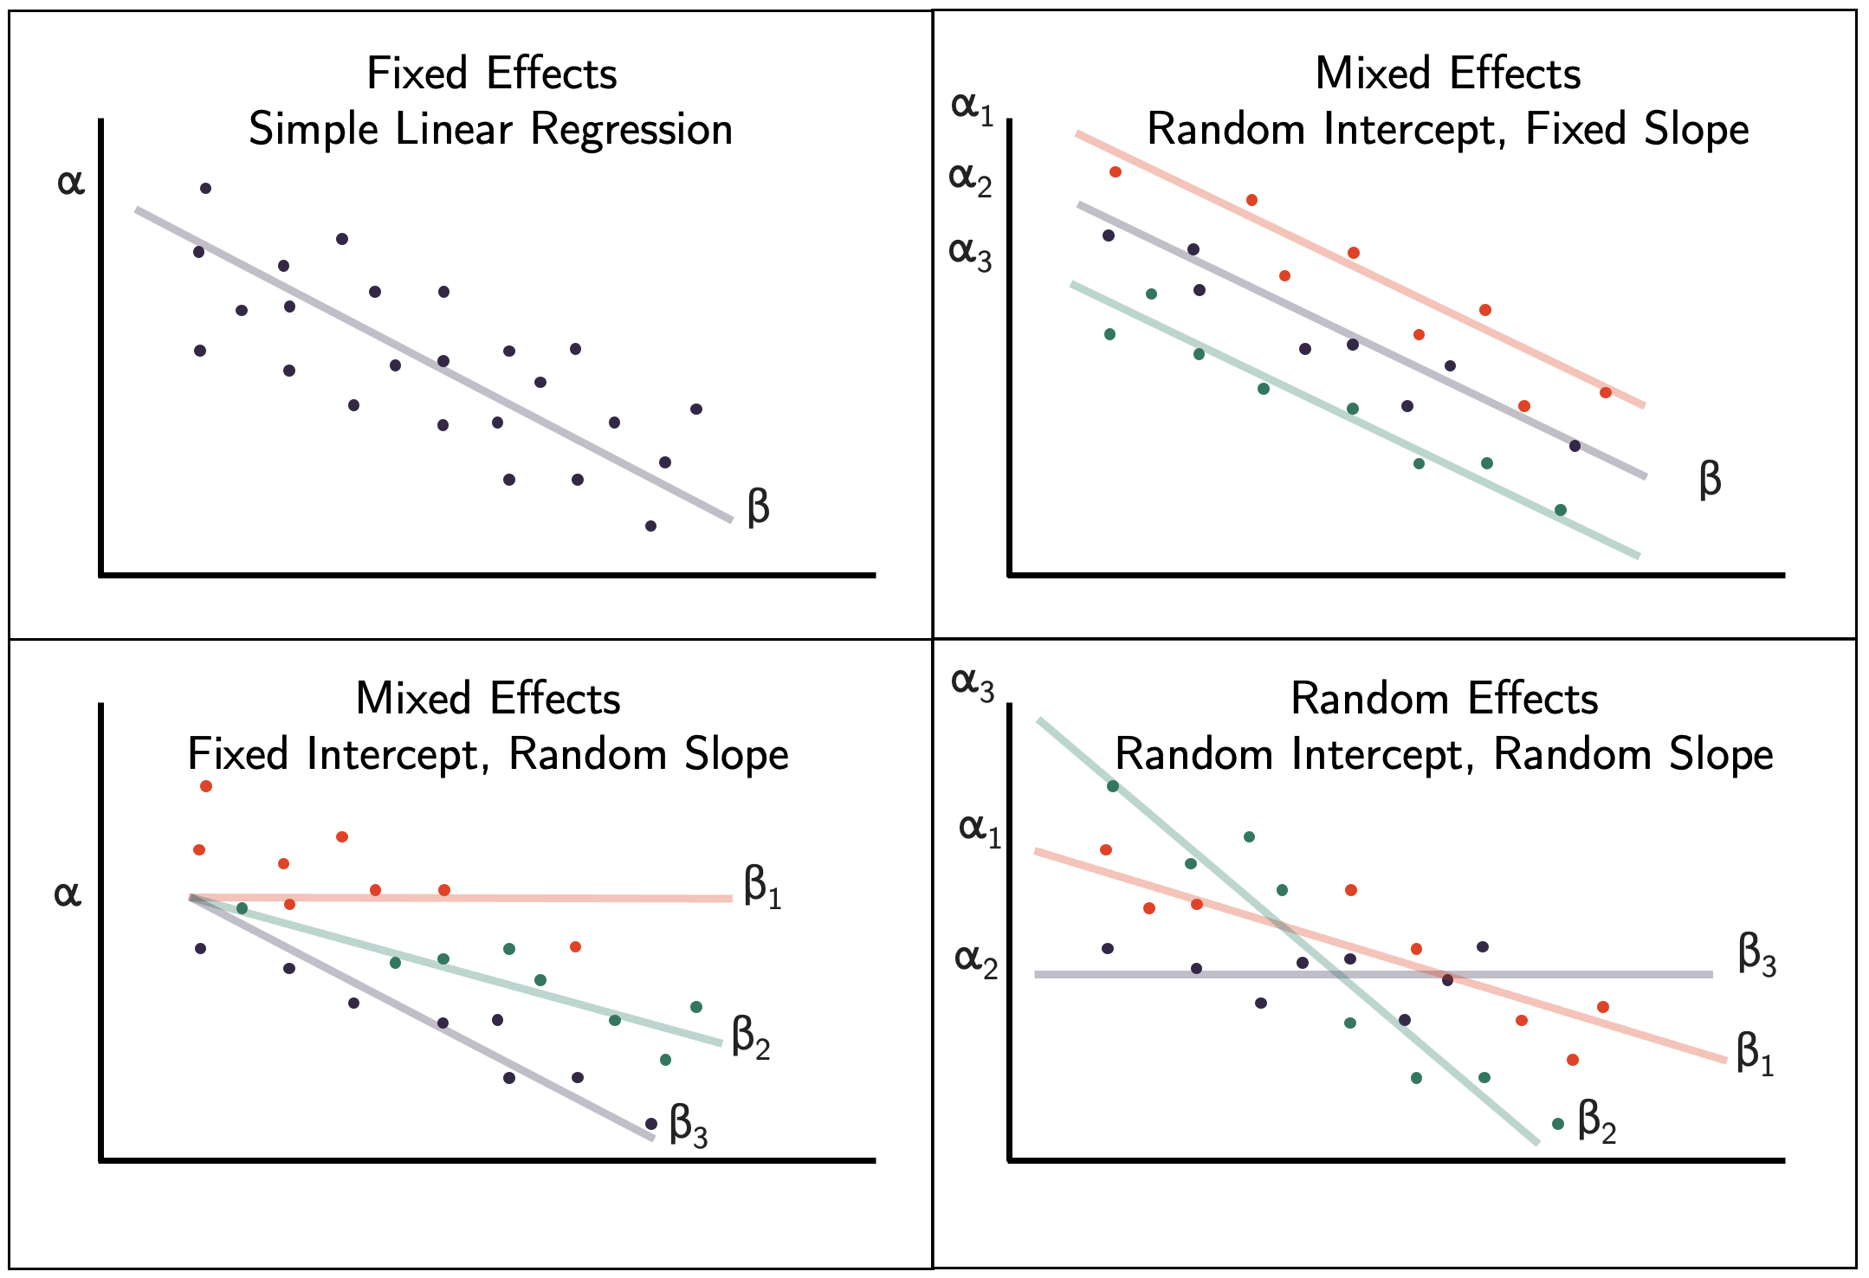
Most common
Best practice
(if not overfit)
Uncommon
https://bookdown.org/steve_midway/DAR/random-effects.html

Slide 12
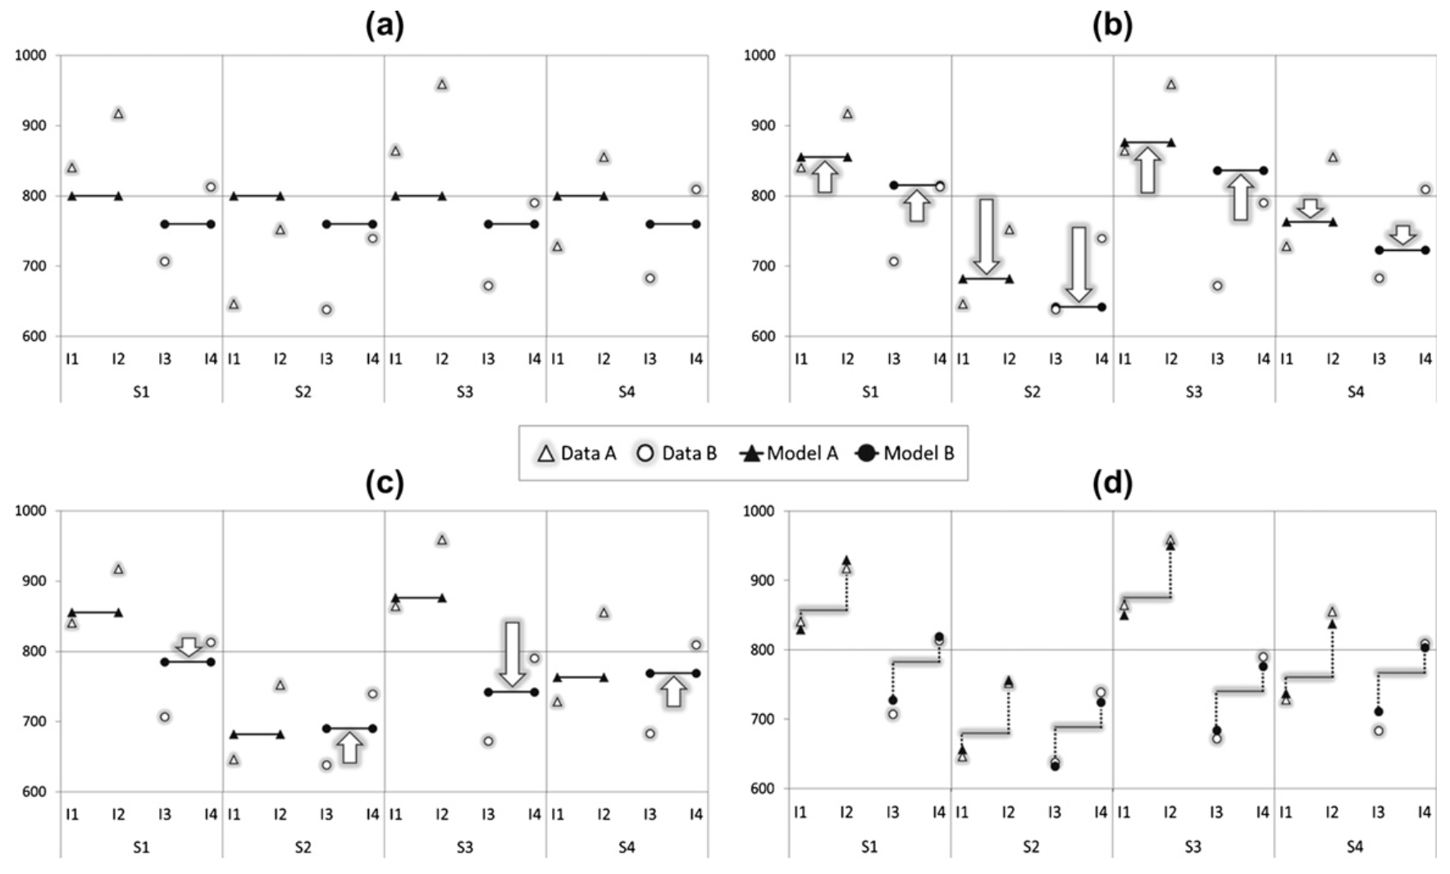
Psycholinguistic data: 4 subjects, 4 items (type A: I1, I2, type B: I3, I4)
No random effect
Random intercept of subject
Random intercept + slope
+ random intercept of item
Random intercept + slope of subject
Barr et al. (2013)

Slide 13
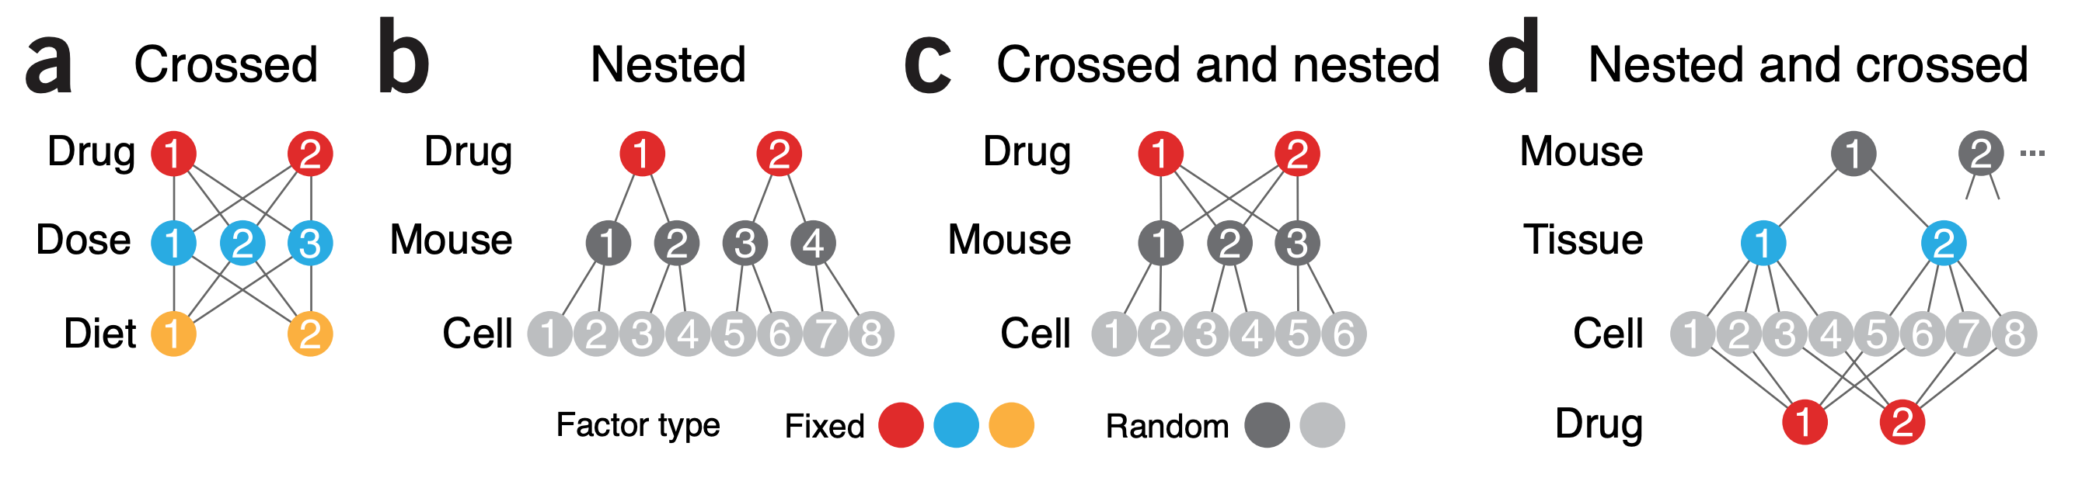
Flexibility of experimental design
Krzywinski et al. (2014)

Slide 14
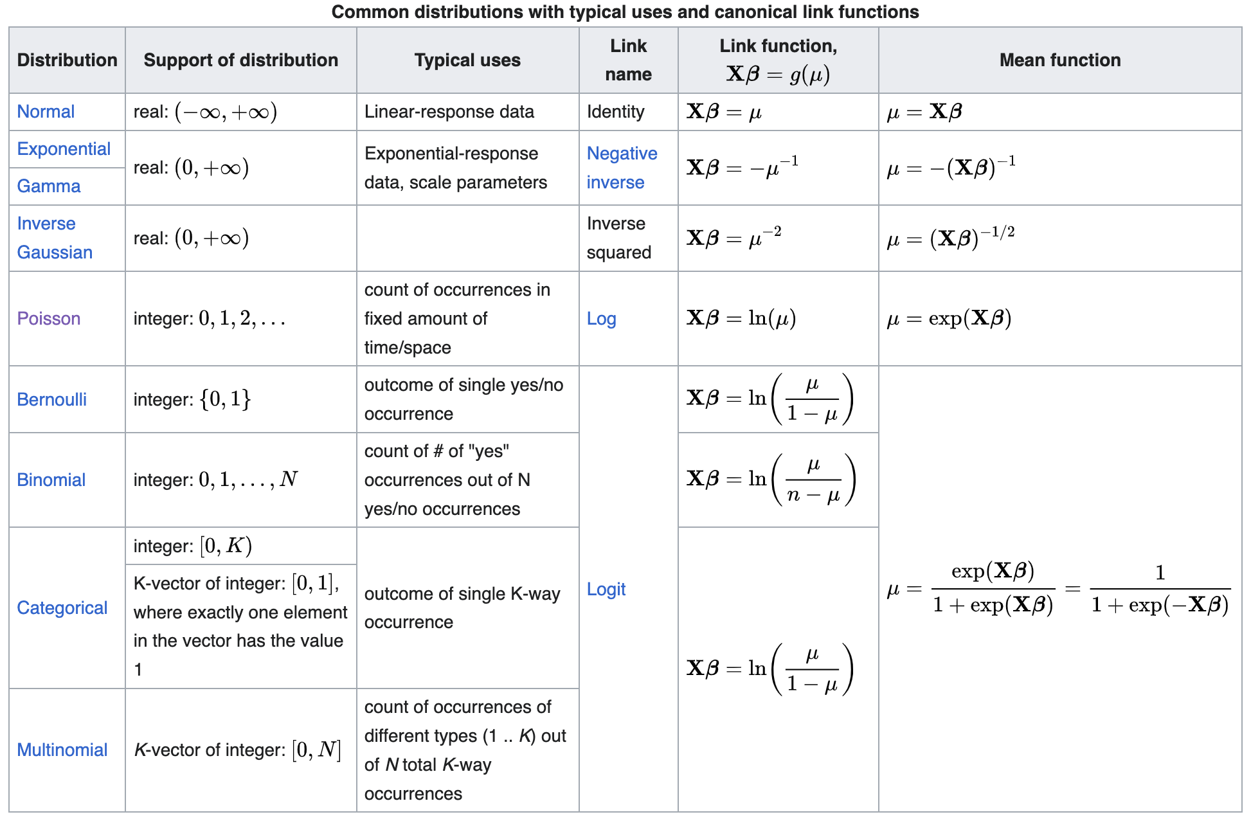
GLM works with mixed effect model too

Slide 15
How much data does a MEM need?
At least 5 random effect levels (subject/group/cluster)
At least 10 observations per level (3 is the absolute minimum)
Imagine you are building a linear regression within each random effect level

Slide 16
Overfitting vs. underfitting
Common (but often suboptimal) approach: including only 1 (or 2) random intercepts
Barr et al. (2013): Keep it maximal
Put all the random intercepts and slopes into the model
Psycholinguistics: by-subject, by-item, etc.
The chances of overfit and non-converging increase too
Bates et al. (2015): Diagnose & simplify the model
Constrain correlation parameters to zero
Drop non-significant variance components and their associated correlation parameters from the model
Step-wise model selection (AIC, BIC)

Slide 17
Recommended readings
Introduction
DeBruine, L. M., & Barr, D. J. (2021). Understanding mixed-effects models through data simulation. Advances in Methods and Practices in Psychological Science, 4(1), 2515245920965119.
Harrison, X. A., Donaldson, L., Correa-Cano, M. E., Evans, J., Fisher, D. N., Goodwin, C. E., ... & Inger, R. (2018). A brief introduction to mixed effects modelling and multi-model inference in ecology. PeerJ, 6, e4794.
Winter, B. (2013). A very basic tutorial for performing linear mixed effects analyses. arXiv preprint arXiv:1308.5499, 1-22.
Advanced guidelines & convergence
Barr, D. J., Levy, R., Scheepers, C., & Tily, H. J. (2013). Random effects structure for confirmatory hypothesis testing: Keep it maximal. Journal of memory and language, 68(3), 255-278.
Bates, D., Mächler, M., Bolker, B., & Walker, S. (2014). Fitting linear mixed-effects models using lme4. arXiv preprint arXiv:1406.5823.
Bates, D., Kliegl, R., Vasishth, S., & Baayen, H. (2015). Parsimonious mixed models. arXiv preprint arXiv:1506.04967.
Simpson’s paradox and pseudoreplication
Kievit, R. A., Frankenhuis, W. E., Waldorp, L. J., & Borsboom, D. (2013). Simpson's paradox in psychological science: a practical guide. Frontiers in psychology, 4, 513.
Lazic, S. E. (2010). The problem of pseudoreplication in neuroscientific studies: is it affecting your analysis?. BMC neuroscience, 11, 1-17.
Zimmerman, K. D., Espeland, M. A., & Langefeld, C. D. (2021). A practical solution to pseudoreplication bias in single-cell studies. Nature Communications, 12(1), 738.
Nested experimental design
Krzywinski, M., Altman, N., & Blainey, P. (2014). Nested designs. Nature Methods, 11(10), 977-979.
Schielzeth, H., & Nakagawa, S. (2013). Nested by design: model fitting and interpretation in a mixed model era. Methods in Ecology and Evolution, 4(1), 14-24.
Generalized linear model
Bolker, B. M., Brooks, M. E., Clark, C. J., Geange, S. W., Poulsen, J. R., Stevens, M. H. H., & White, J. S. S. (2009). Generalized linear mixed models: a practical guide for ecology and evolution. Trends in Ecology & Evolution, 24(3), 127-135.
Logistic model
Brown, V. A. (2021). An introduction to linear mixed-effects modeling in R. Advances in Methods and Practices in Psychological Science, 4(1), 2515245920960351.
Kim, Y., Choi, Y. K., & Emery, S. (2013). Logistic regression with multiple random effects: a simulation study of estimation methods and statistical packages. The American Statistician, 67(3), 171-182.

Slide 18
R packages
Core: lme4 (citation: 58173, first published in 2003)
Visualization: sjPlot, ggeffects
and many other for ordinal data, nonlinear model, GLM, MCMC bootstrapping, etc.
Python: statsmodels

Slide 19
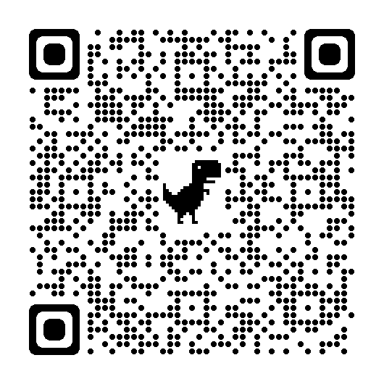

Time to code

Slide 20
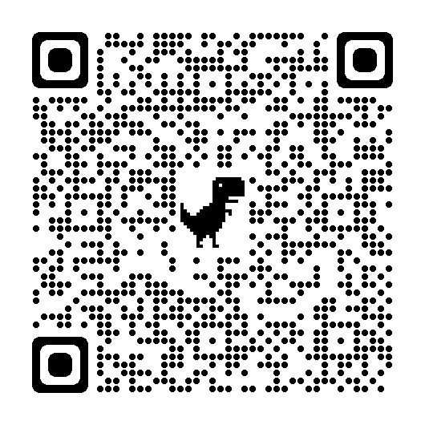
Feedback form
https://forms.gle/pnGyBtNS7ayzHpxT7

Slide 21
Implicitly nested
Bavarian
Ligurian
Emmental
mountainRange
A
B
C
A
B
C
A
B
C
site

Slide 22
Explicitly nested
Bavarian
Ligurian
Emmental
mountainRange
A
B
C
D
E
F
G
H
I
site

Slide 23
Fully crossed
Bavarian
Ligurian
Emmental
mountainRange
A
B
C
site

